Slide 1
Software Engineering & Testing
Arun Kudur – 01/03/2024

Slide 2
Unit I
Introduction
Software Crisis,
Need for Software Engineering
Professional Software Development, Software Engineering Ethics, Case Studies.
Software Processes: Models:
Waterfall Model Incremental Model and Spiral Model, Process activities.
Requirements Engineering:
Functional and non-functional requirements
Requirements Engineering Processes
Requirements Elicitation and Analysis
Requirements Specification
Software Requirements Document, Requirements Validation and Management
System Models:
Context models, Interaction models, Structural models, Behavioral models

Slide 3
Course Schedule
Fridays – 2 to 4:15 pm
2 pm to 3 pm
15 mins break
3:15 to 4:15 pm
Arun Kudur

Slide 4
What will you learn?
Course Learning Objectives:
1. Learn the concepts and importance of software engineering and testing.
2. Learn strengths and weaknesses of various software engineering techniques used in industrial applications.
3. Select appropriate testing strategies based on the application
4. Analyse various software testing tools and techniques used in the industrial applications.
5. Able to construct software that is reasonably easy to understand, modify, maintain, reliable and test.
Arun Kudur

Slide 5
What is software engineering?

Slide 6
Why software testing?

Slide 7
Who should be testing software?

Slide 8
What types of testing are there?

Slide 9
Professional Software Development
Arun Kudur – 08/03/2024

Slide 10
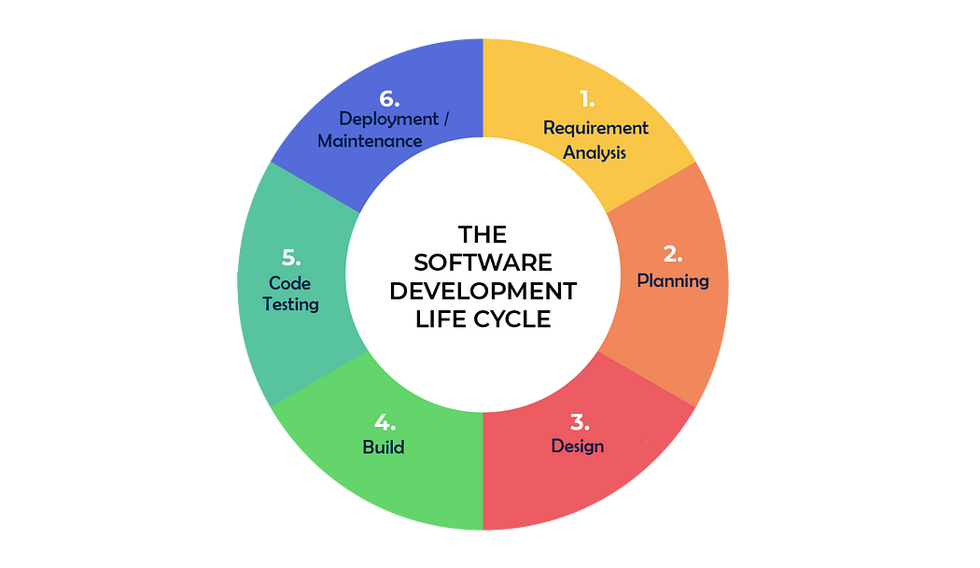
The Software Development Life Cycle

Slide 11
Methodologies
Waterfall
Agile
Kanban
Scrum
Notes:
Let’s say we give you a group project to develop some software application. How will you go about it?

Slide 12
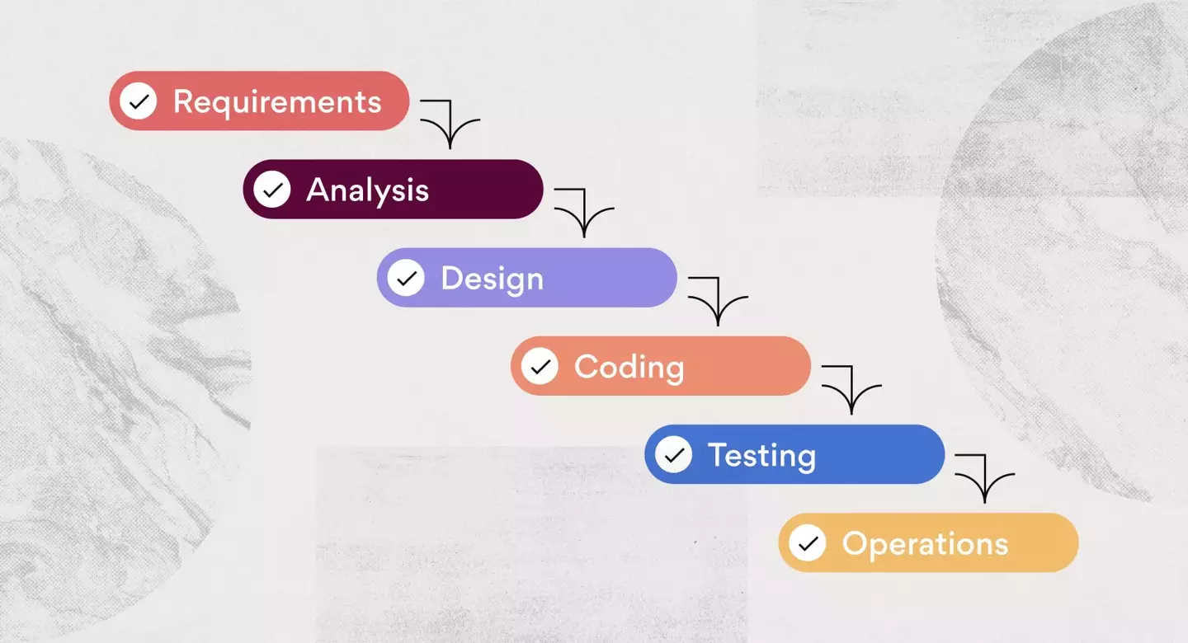
Waterfall

Slide 13
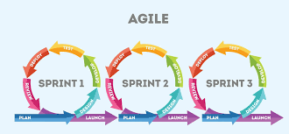
Agile

Slide 14
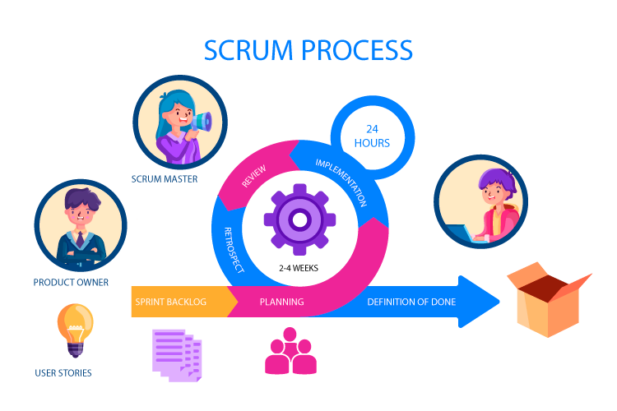
Scrum

Slide 15
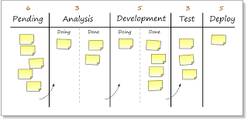
Kanban

Slide 16
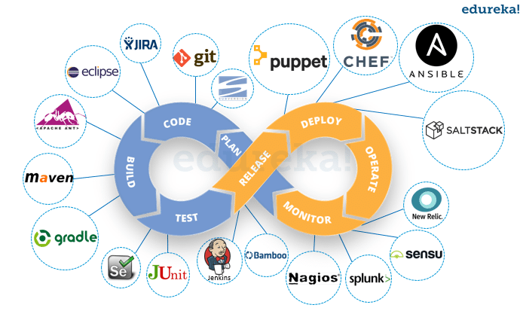
Tools used in various stages of SDLC - DevOps

Slide 17
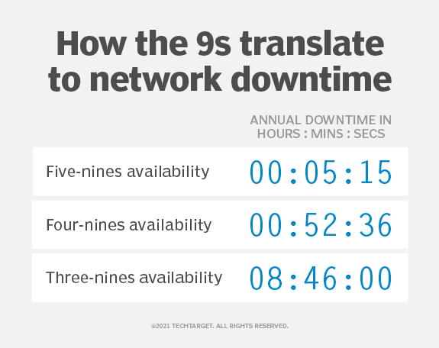
The Magic of 99.999%
AWS S3 Storage

Slide 18
Downtime of 1 minute = $$$$$$$
For a company such as Amazon, even one single minute of downtime can cost as much as $220,318.80 according to the latest calculations.

Slide 19
Requirements
Arun Kudur – 15/03/2024

Slide 20
Agenda
Functional & Non-Functional Requirements
Requirements Engineering Processes
Requirements Elicitation and Analysis
Requirements Specification
Software Requirements Document
Requirements Validation and Management

Slide 21
Functional and Non-Functional Requirements
Functional Req 1
…
…
…
…
Non-Functional Requirement 1
…

Slide 22
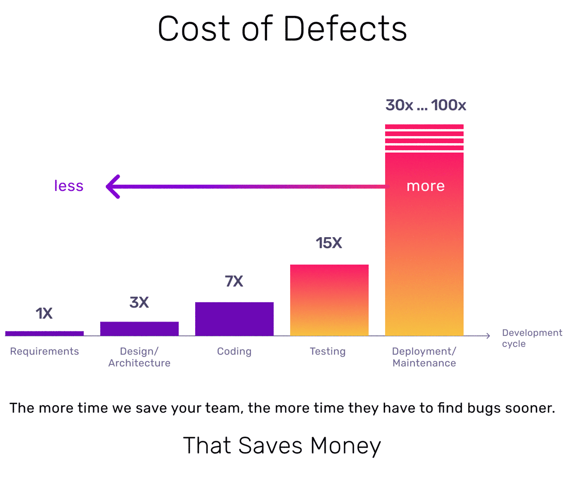
Requirements Engineering

Slide 23
Requirements Engineering Phases
Elicitation
Analysis
Specification
Validation
Management

Slide 24
Discuss how each phase looks like and list the challenges in each
Elicitation
Analysis
Specification
Validation
Management

Slide 25
Unit Testing (in Python)
Arun Kudur – 15/03/2024

Slide 26
System Models
Arun Kudur – 22/03/2024

Slide 27
Agenda
Understanding System Models
Context Model
Interaction Model
Structural Model
Behavioral Model

Slide 28

Activity - Let’s gather some requirements to build a house

Slide 29
External Perspective – Context Model
Appointments and Scheduling
Patient Encounter Management
Refer to Providers Outside
Patient Registration Management
Hospital Management System
Providers Management
Billing Management
Insurance Companies
Inventory/Facilities Management

Slide 30
Interaction Perspective – Interaction Model
Billing Management
Lookup for Patient Schedule
Assign a Provider
Bill Patient
Matched
Schedule
Patient
Arrives
No schedule found
Check out Patient
Patient
Leaves

Slide 31
Structural Perspective – Structural Model
Patient
Patient Record
1
1
UML Classes and Association

Slide 32
Structural Model – Patient Encounter (Visit)
Specialist
1
referred to
1 .. *
Condition
1 .. *
1 .. *
Patient
1 .. *
1
General Practitioner
diagnosed with
is referred by
1
Is scheduled
1 .. *
prescribes
1 .. *
Medicines
Visit
1 .. *
1 .. *
prescribes
Procedure
1 .. *

Slide 33
Class Diagram – Entity Representation
Patient
Patient ID Patient Name Gender Blood Group Date of Birth Address Email ID Phone No
getPhoneNo() setPhoneNo() getDOB() getBloodGroup() getName()
Patient Record
Primary Provider Insurance ID Last Visit Date Last Seen Provider … … …
getInsuranceID() getLastVisit() .. .. .. ..

Slide 34
Behavioral Perspective – Behavioral Model
Data Driven
Event Driven

Slide 35
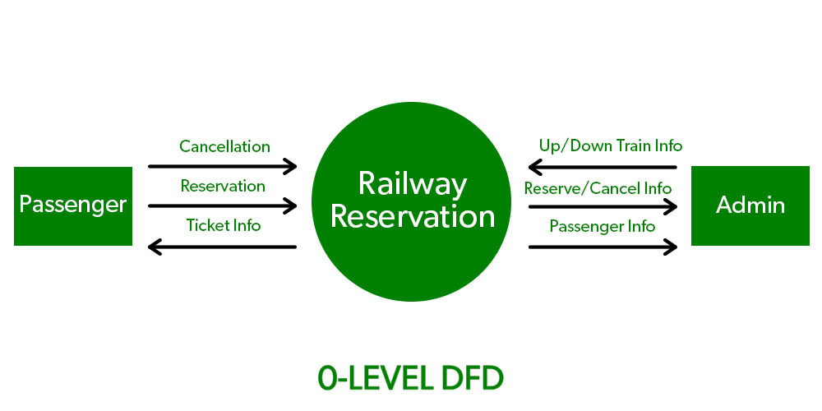
Data Flow Model (Sequence Diagram)

Slide 36
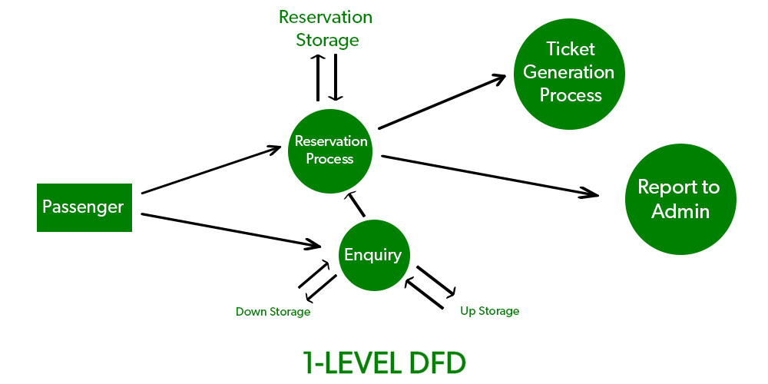
Sequence Diagram

Slide 37
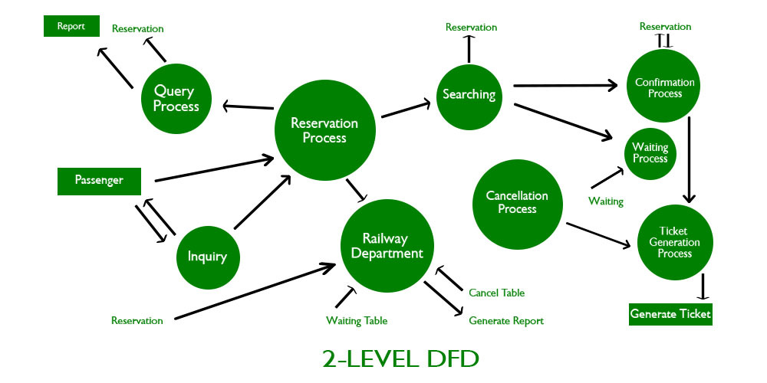
Sequence Diagram

Slide 38
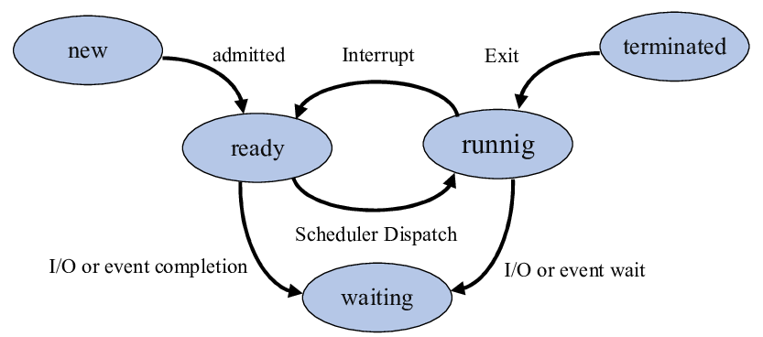
Event Driven Model (State Diagram)

Slide 39
Unit II
Architectural Design:
Architectural Design Decisions
Architectural Views and Patterns, Application Architectures
Agile Software Development:
Coping with Change
The Agile Manifesto: Values and Principles, Agile methods and Extreme Programming, Plan-driven and agile development, Agile project management, Scaling agile methods
Software Testing:
Introduction, Development testing, Test-driven development, Release testing, Test Automation

Slide 40
Architectural Design
Architectural Design
Identify sub-systems that make up the system
The relationships between these sub-systems
Software Architecture
Description of how a software system is organized

Slide 41
The Design Process
Design Inputs
Platform Information
Requirements Specification
Data Description
Architectural Design
Interface Design
Component Design
Design Activities
Database Design
Design Output
System Architecture
Database Specification
Interface Specification
Component Specification

Slide 42
Architectural Design
Critical link between Requirements Engineering and the Design Process
First stage of the software design process
In an iterative development, the overall architecture is designed and implemented in the first iteration

Slide 43
Architectural Design
Architecture in the small is concerned with: -
the architecture of individual programs
how an individual program is decomposed into components.
Architecture in the large is concerned with: -
the architecture of complex enterprise systems that include other systems and programs.
how it is distributed over different computers

Slide 44

Activity – Push vs Pull Architecture

Slide 45
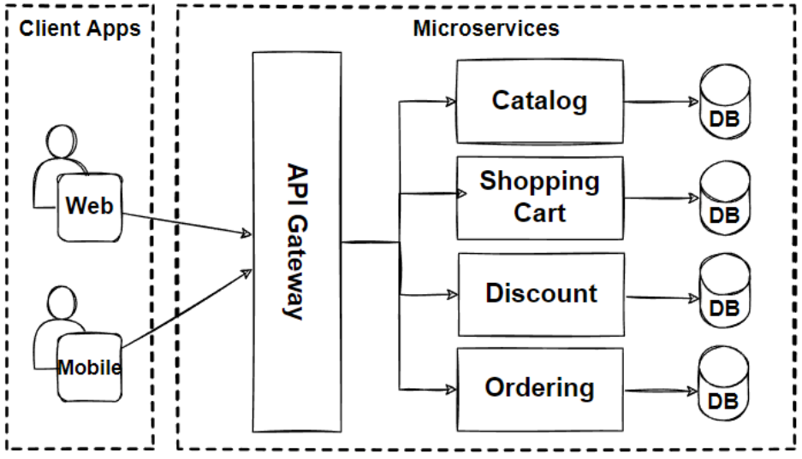
Microservice Architecture

Slide 46
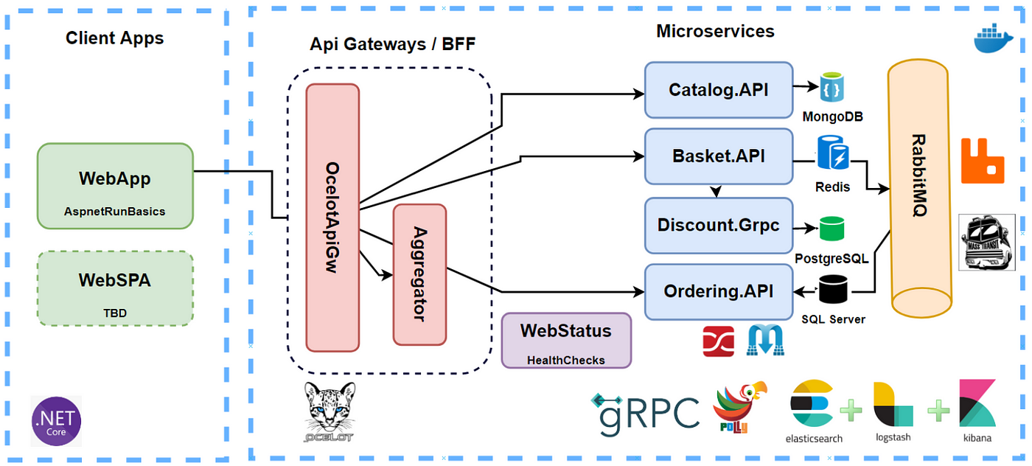
Detailed View

Slide 47
Common Architectural Patterns White Box vs Black Box Testing Agile
Arun Kudur – 12/04/2024

Slide 48

Common Architectural Patterns
Layered Architecture
Event Driven Architecture
Microkernel Architecture
Microservices Architecture
Client-Server Architecture
Pipe-Filter Architecture
Broker Architecture
Peer-To-Peer Architecture

Slide 49
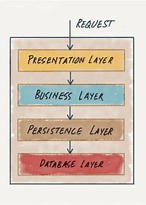
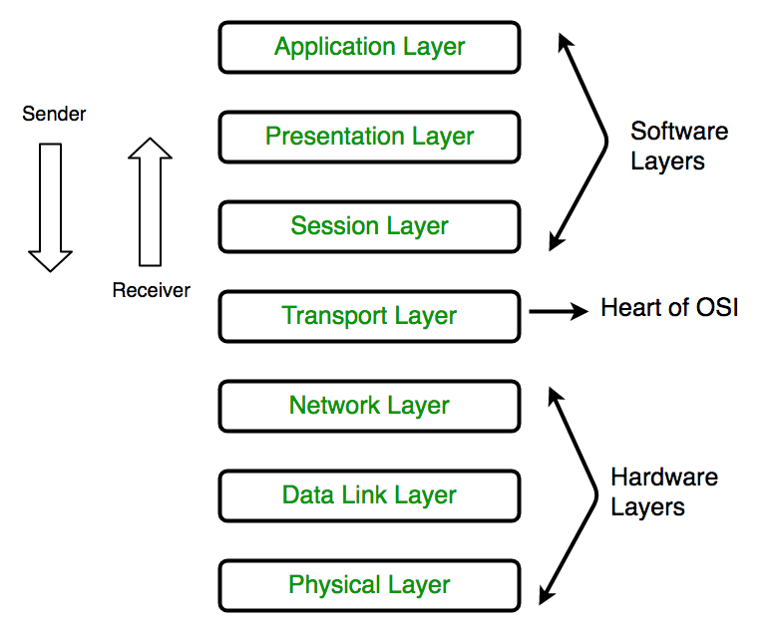
Layered Architecture

Slide 50
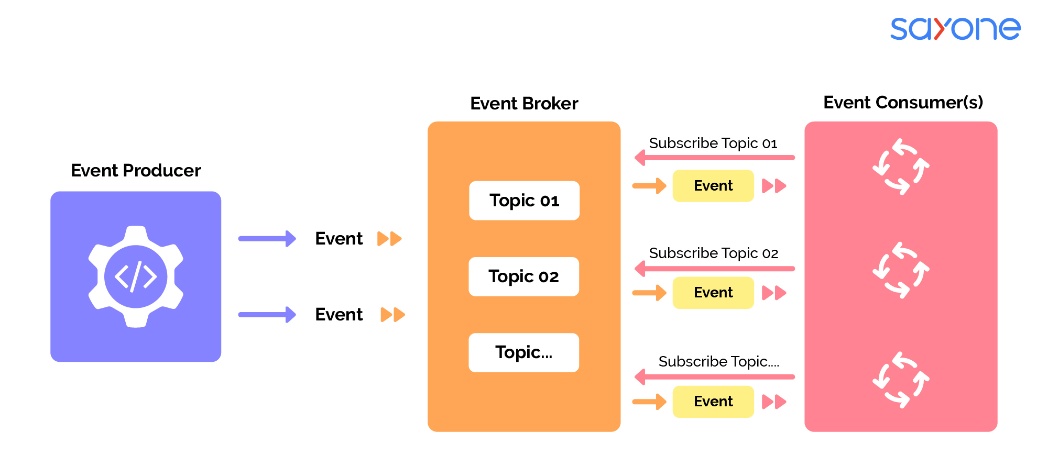
Event Driven Architecture

Slide 51
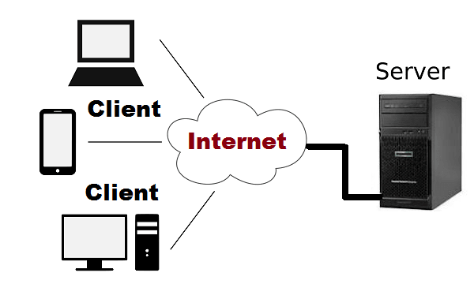
Client-Server Architecture

Slide 52
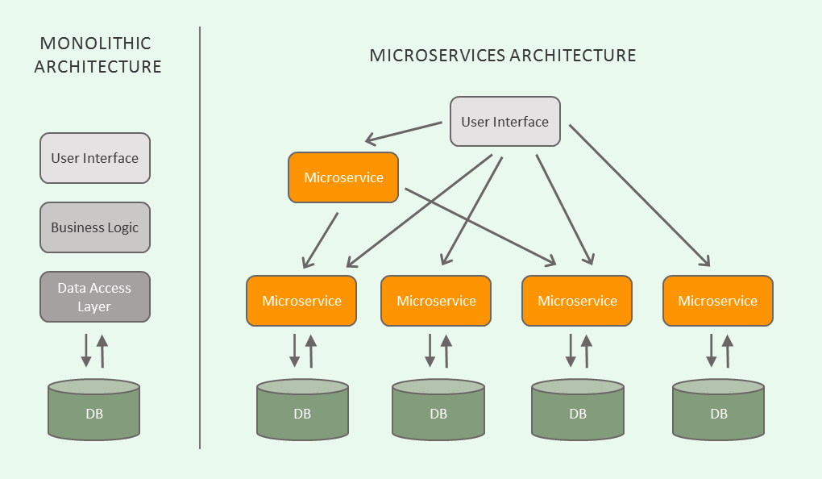
Microservices Architecture

Slide 53
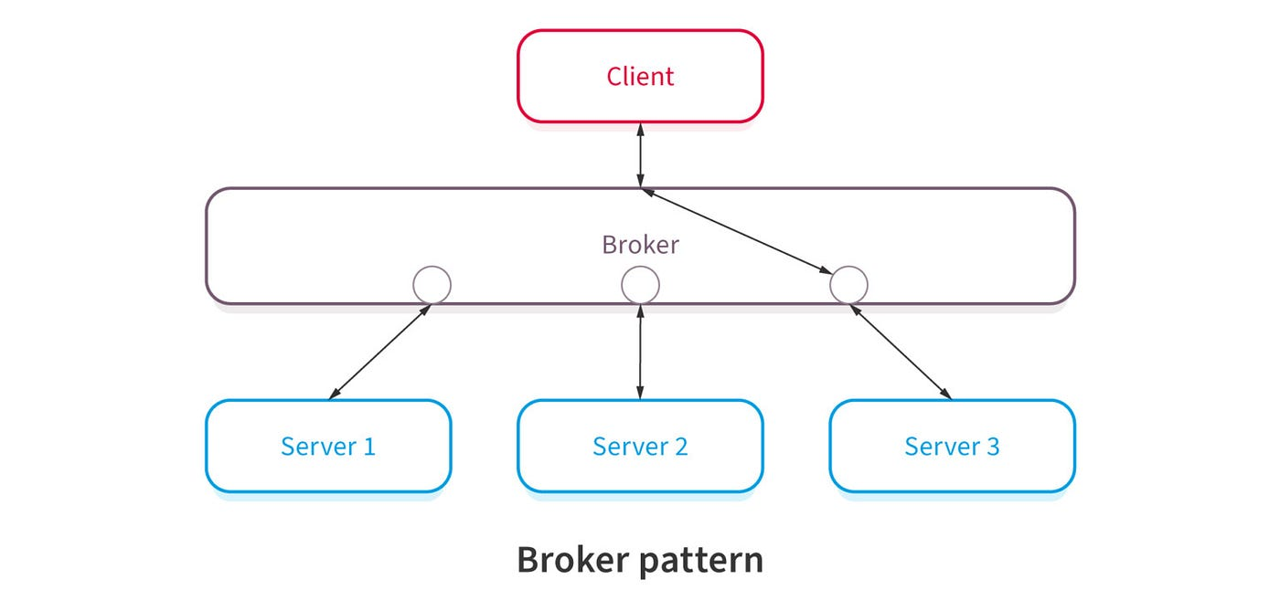
Broker Architecture

Slide 54
Types of Testing
Black Box
White Box

Slide 55
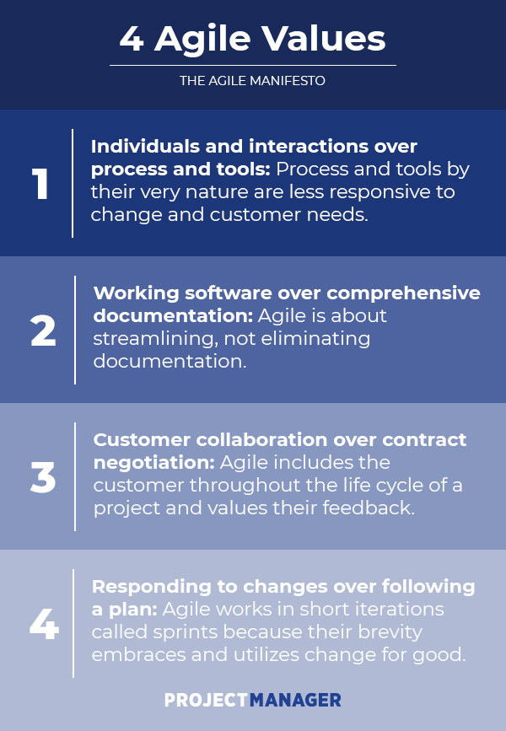
The Agile Manifesto

